Slide 1




NFH (original); 31, 4
NFHD2; 40, 4
D2: delete 36-72
Rerun alg on D2
NFH (phos); 36, 4
NFHD2 (phos); 33, 4
Note: not currently doing this

Slide 2
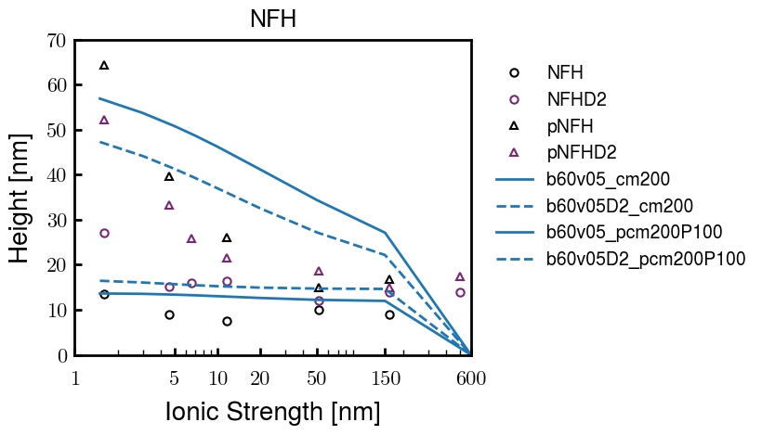
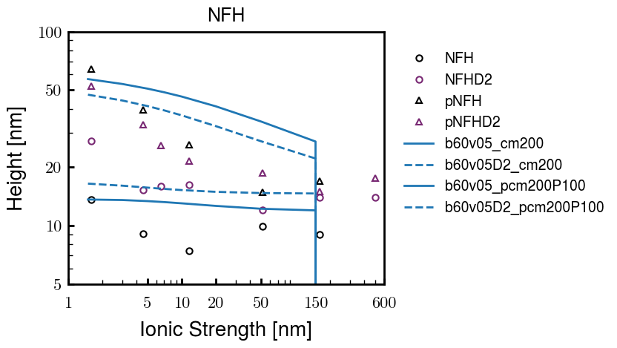
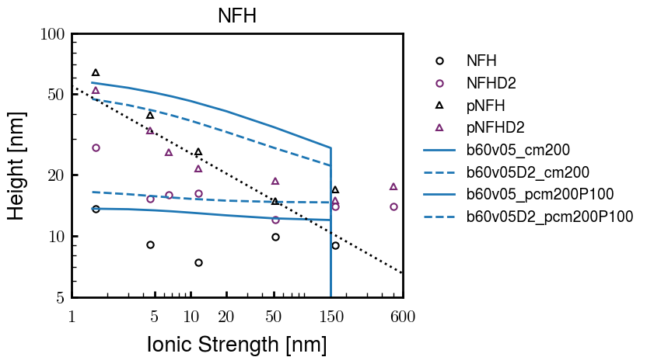
Best so far (10/10)
3e-04
3e-04

Slide 3






Native NFH

Slide 4







NFHD2

Slide 5



pNFH(D2)

Slide 6




1e-06
4e-03
norm
4e-03
Try to bring pNFH down → {cmXX + PXX} only choice

Slide 7





Heights.params : b60v05 cm200
norm
1e-06
1e-05
1e-04
4e-03

Slide 8






Heights.params : b60v05 cm250
norm
ylog
norm
ylin
1e-06
1e-05
1e-04
5e-03

Slide 9




Heights.params: b60v10 cm{200, 225}
norm
1e-06
1e-05
1e-04
5e-03

Slide 10



Slide 11



 | Slope Bins 4 | Smear Count 25
Block number | Alpha w/ Henderson Hasselbalch | Chi Chi_max = 2.2
[0 50] | 0.040012 | 1.160000
[50 75] | -0.278451 | 0.720000
[75 125] | -0.519707 | 0.608000
[125 156] | -0.154453 | 0.529032

Slide 12


 | Slope Bins 4 | Smear Count 31
Block number | Alpha w/ Henderson Hasselbalch | Chi Chi_max = 2.2
[0 31] | 0.001103 | 0.922581
[31 62] | -0.386873 | 0.703226
[62 93] | -0.290146 | 0.967742
[93 496] | 0.037164 | 1.098759
[496 527] | -0.064533 | 0.819355
[527 620] | 0.010682 | 0.756989
[620 647] | -0.103326 | 0.696296

Slide 13






Previous
New

Slide 14





Slide 15


Response to stimuli given composition
Same data
Effect of composition given environment

Slide 16


NFL, pH 7.44, phos 1.5e (locs from LCMS)
Non-phos NFL
Block number | Alpha w/ Henderson Hasselbalch | Chi Chi_max = 3.2
[0 50] | 0.040012 | 1.540000
[50 75] | -0.278451 | 0.960000
[75 125] | -0.519707 | 0.868000
[125 156] | -0.154453 | 0.690323
 | Slope Bins 4 | Smear Count 25
Block number | Alpha w/ Henderson Hasselbalch | Chi Chi_max = 3.2
[0 50] | -0.019988 | 1.540000
[50 75] | -0.278451 | 0.960000
[75 125] | -0.519707 | 0.868000
[125 156] | -0.154453 | 0.690323

Slide 17


NFM, pH 7.44, phos 1.5e (locs from LCMS)
 | Slope Bins 4 | Smear Count 32
Block number | Alpha w/ Henderson Hasselbalch | Chi Chi_max = 3.0
[0 32] | 0.079143 | 1.275000
[32 64] | -0.186340 | 1.125000
[64 96] | -0.327964 | 1.181250
[96 160] | -0.460694 | 0.787500
[160 224] | -0.124999 | 1.115625
[224 288] | -0.023510 | 0.956250
[288 352] | -0.242085 | 1.003125
[352 384] | -0.031302 | 1.125000
[384 416] | -0.123860 | 1.050000
[416 438] | 0.046945 | 1.281818

Slide 18





Bin 3 NFM, pH 7.44, phos 1.5e (locs from LCMS)

Slide 19




Bin 5 NFM, pH 7.44, phos 1.5e (locs from LCMS)

Slide 20



Phos 2 NFM, pH 7.44, phos 2.0e (locs from LCMS)

Slide 21



Chi 2.5 NFM, pH 7.44, phos 2.0e (locs from LCMS)

Slide 22



NFM, pH 7.44, non-phos

Slide 23


NFH, pH 7.44, phos 1.5e (locs from LCMS)
 | Slope Bins 4 | Smear Count 36
Block number | Alpha w/ Henderson Hasselbalch | Chi Chi_max = 3.2 | Chi Chi_max = 3.0
[0 36] | 0.000945 | 1.266667 | 1.20000
[36 72] | -0.527455 | 0.900000 | 0.85000
[72 324] | -0.208376 | 1.729365 | 1.628571
[324 396] | -0.111195 | 1.416667 | 1.333333
[396 432] | -0.152824 | 1.344444 | 1.266667
[432 647] | -0.033955 | 1.077209 | 1.015814

Slide 24




Phos block dashed
Phos block dashed

Slide 25



Best are b3.0 v2.0 and b3.0 v3.0, but max H not high enough
Possible solutions:
Lower chi_max
Change aa_disc to have more charge
Force spectra?
Better for low salt, but high salt will melt brushes together

Slide 26



M1
pMx5

Slide 27



b3.00; v1, 2
b4.00; v2, 2.5, 3, 5, 10
b5.00; v3, 10, 15, 40
53 Nk
39 Nk
32 Nk

Slide 28
Binary results

Slide 29



Matrix Approach
Updated 04/04/2023

Slide 30














H Vol decrease (by v)
H Vol decrease (by b)
Desired “linearity” by tuning /thresh/ based on polymer density of expelled NFL
L Vol decrease (by b)
Comes at severe cost of overall height. Have to minimize outer concentration to approach pure thresh of 1e-06

Slide 31














H Vol decrease (by v)
H Vol decrease (by b)
Chimax 3.5
Desired “linearity” by tuning /thresh/ based on polymer density of expelled NFL
L Vol decrease (by b)
Comes at severe cost of overall height. Have to minimize outer concentration to approach pure thresh of 1e-06

Slide 32








F (3.5)
Chimax 3.5
Chimax 3.0
Scaled by 1.5
Scaled by 1.6
Scaled by 1.6
Scaled by 1.5
Scaled by 1.5
Scaled by 1.5
Scaled by 1.8
Scaled by 1.8

Slide 33
















Last test: same stiffness factor (b^3/v0) but with varying total volume

Slide 34












H Vol decrease (by v)
H Vol decrease (by b)
a2C_30
a2D_30
a2E_30
Rerun for Cs
b1C_30
b1D_30
b1E_30
L Vol decrease (by b)
a1C_30
a1D_30
a1E_30
g1C_30
g1D_30
g1E_30
Rerun for Cs

Slide 35












H Vol decrease (by v)
H Vol decrease (by b)
a2C
a2D
a2E
b1C
b1D
b1E
Block 4 (NFL end)
L Vol decrease (by b)
a1C
a1D
a1E
g1C
g1D
g1E

Slide 36









H Vol decrease (by v)
Chimax 3.5
H Vol decrease (by b)
a2C_30
a2D_30
a2E_30
b1C_30
b1D_30
b1E_30
L Vol decrease (by b)
a1C_30
a1D_30
a1E_30
g1C_30
g1D_30
g1E_30

Slide 37







For i as L and H:
Pure height profiles
Mixed height profiles
Current L library
Current H library
Skip; marginal increase in vol prob not enough
Move onto chi3.0; larger NFL vol library

Slide 38





NFL
All plotting wrong L pure; look only at purp
NFH
H volume too low to neutralize L (v = 31 nm3/c)

Slide 39







H volume v = 60 nm3/c

Slide 40







H volume too low to neutralize L

Slide 41










NFH, V = 70
L30

Slide 42





NFH & NFL v = 0.15
a2D
b1D
g1D

Slide 43





Based on NFH b5v15c3, apply VL = VH
NFL and NFH are from same amino acids but diff chain lengths. Should VL = VH?
L30 / H70
L80 / H20
L30 / H70
L80 / H20

Slide 44






L30 / H70
L80 / H20
L30 / H70
L80 / H20

Slide 45
L Fitting

Slide 46


VL = VH

Slide 47







Try b change, v same as H (0.15)
Phi unrealistic (?)
Phi unrealistic
Phi very unrealistic
Phi very unrealistic

Slide 48






Try similar params to H
5.6
11.2
16.8
28
56
7.5
11.25
18.75

Slide 49







Try similar params to H, b0.36
7.8
15.6
23.4
31.2
Unrealistic vol
Not very sensitive to v; not high enough to intersect neighboring chains (function of b and sigma)

Slide 50


Continuation from prev params

Slide 51







v2.7 and some fine
b1.50 v2.7 c3.2
b1.75 v2.7 c3.2
b1.75 v2.5 c3.2
b1.75 v2.5 c3.0
b2.0 v2.7 c3.2
b2.25 v2.7 c3.2
b2.50 v2.7 c3.2
Phi too small to decrease v0

Slide 52










b2.0 v10.0 c3.0
b2.0 v8.0 c3.0
b2.0 v6.0 c3.0
b2.0 v4.0 c3.0
b2.0 v2.0 c3.0
Phi limit
b1.8 v10.0 c3.0
b1.8 v8.0 c3.0
b1.8 v6.0 c3.0
b1.8 v3.0 c3.0
b1.8 v2.0 c3.0
Phi limit

Slide 53





b1.6 v10.0 c3.0
b1.6 v8.0 c3.0
b1.6 v6.0 c3.0
b1.6 v2.0 c3.0
b1.6 v1.5 c3.0
Phi limit

Slide 54









b2.0 v2.7 c3.2
b3.0 v3.5 c3.5
b3.0 v7.0 c3.5
b3.0 v7.0 c3.0
Phi too small
Phi too small to decrease v0
b4.0 v12.0 c3.0
b5.0 v20.0 c3.0
b5.0 v20.0 c4.0
b5.0 v5.0 c3.0
b5.0 v10.0 c3.0
Phi too small to decrease v0

Slide 55





v20
b5.0 v20.0 c3.0
b4.5 v20.0 c3.0
b4.0 v20.0 c3.0
b3.5 v20.0 c3.0
v10
b5.0 v10.0 c3.0
b4.0 v10.0 c3.0
b3.0 v10.0 c3.0
b2.0 v10.0 c3.0

Slide 56




b2.00 v2.70 c3.20
b2.00 v2.75 c3.20

Slide 57
NFH fitting (from NFL best fit)

Slide 58








b1.00, v0.50, c3.2
b2.00, v4.00, c3.2, th2.5e-02
b1.00, v2.00, c3.2
b1.00, v1.00, c3.2

Slide 59
Mixture

Slide 60



Slide 61


b = 0.75

Slide 62





Slide 63
b = 1.0

Slide 64





Slide 65
b = 1.25

Slide 66




Chi 2.6
Bad vol frac

Slide 67








b25v0
b25v1
b25v2
b25v3

Slide 68




Chi 2.8
Bad vol frac

Slide 69





Slide 70
b = 1.50

Slide 71






Chi 2.8
Bad vol frac

Slide 72





Slide 73

b = 2.00
v4 = 0.25*b^3

Slide 74


Bad vol frac

Slide 75



Slide 76
Fine tune

Slide 77



b1.25, v1.95, c3.0
b1.50, v3.38, c3.0
b2.00, v4.00, c3.0
Norm seems to capture kinked behavior

Slide 78




Slide 79



b1.25, v1.95, c3.2
b1.50, v3.38, c3.2
b2.00, v4.00, c3.2

Slide 80




Slide 81


b1.25
b1.50
b2.00
c2.8
c3.0
c3.2

